Slide 1
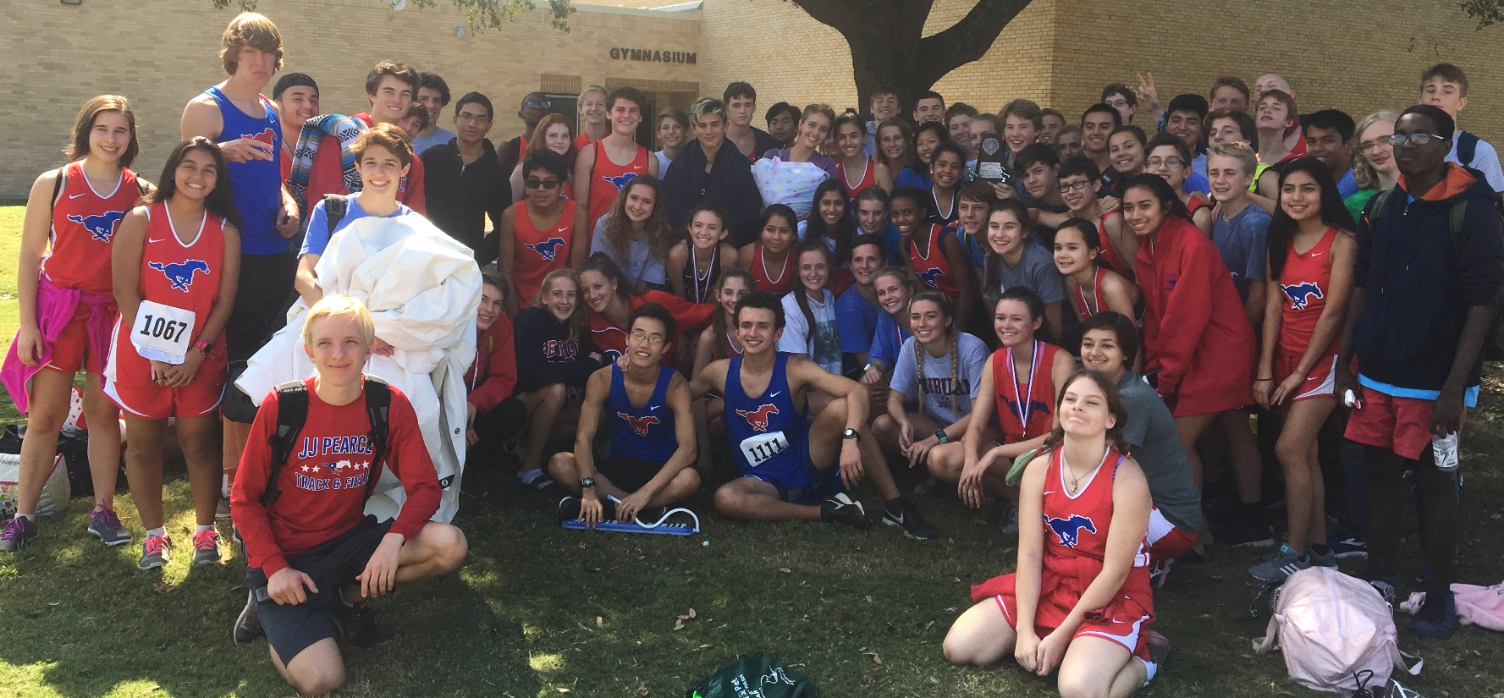
JJ Pearce Cross Country
Parent Meeting
Coaches: Lindsay Ledford; Scott Reid

Slide 2
Parent Team Reps
Jeannie Salony: Team parent
Lisa Gesin: Media Guide
Need volunteers for: Banquet, Clinic, Photos, Trip, Twitter/Website

Slide 3
Membership Toolkit
www.pearceathletics.org
Create a free account and select cross country as your child’s sport to receive emails
Purchase spirit wear
Purchase banquet tickets
Team dinner RSVP and sign ups
Join Booster Club
THIS IS THE ONLY WAY TO RECEIVE OUR EMAILS!!

Slide 4
JOIN REMIND/KEEP UP WITH US
Text jjpxc19 to 81010
Website: pearcexc.weebly.com
Twitter: @jjpearcexc

Slide 5
Athletic Paperwork
Will all be done online through RankOne (richardsonisd.rankonesport.com)
Must have paperwork on file in order to practice with team

Slide 6
Physical Evaluation
Required for every student athlete
Physicals must be completed on the UIL form (see richardsonisd.rankonesport.com or risd.org for the form
Cannot have your DR/Pediatrician’s form
Need to be renewed each calendar year
Places to go:
Primacare
Questcare
Your own Doctor/Pediatrician

Slide 7
Registering for Cross Country
You can register for first period or zero hour Cross Country
Zero hour – Only meet before school and does not affect periods during school day
If you are in another athletic period do not register for ANY XC period
For Example: Soccer / Basketball/ Wrestling / etc.

Slide 8
Summer Practices
Summer running is crucial to success in the fall
Calendar will be posted on website and emailed each month
We will increase # of runs, distance, and intensity as summer progresses
Hydration is extremely important
ALWAYS BRING WATER
Injuries
If runners have any nagging injuries, they are encouraged and expected to speak with trainers.
Always follow up with Coach Ledford

Slide 9
Summer schedule
June 3 – June 28 @ 6:30
Monday – Gold’s Gym (Campbell/75)
Wednesday – Campbell Green Park
Friday – PHS Track
July 1 – July 26 @ 6:30 (No practice July 4th)
Monday – Gold’s Gym
Tuesday/Thursday – PHS Track
Wednesday – Campbell Green
July 29 – Rest of Season (**MANDATORY**)
Monday – Gold’s Gym
Tuesday/Thursday/Friday – PHS Track
Wednesday – Campbell Green

Slide 10
Meets – What to Expect
Meets will be broken into 4 races
Girls Varsity / Boys Varsity / Girls JV / Boys JV
7-10 Runners can run on varsity
Unlimited runners can run JV
Distance for meets is 5000 meters (5k – 3.1 miles)
Times for each race will be sent out before the meet each week

Slide 11
Team Fundraising
Purpose:
Trip to Austin
Banquet-All runners invited at no cost
Last year was huge success-over 200 people, nearly all runners!
Hydration system
Travel gear
Tent/Tarp
Team posters

Slide 12
Team Fundraising cont.
Fundraising Opportunities
PABC Fundraiser
Dates-9/3-9/18
More details to come
Volunteering at the Mum Store
Chipotle night – TBA

Slide 13
Team Fundraising cont.
Media Guide Ad Sales
June 13th – Protected Advertisements Released
July 13th – Team Representatives should have all contracts & payments in hand, none pending
Professional Photographer, Albert Pena, with G3 Photography, will be available to take student pictures to accompany advertisements ($30 paid by XC budget)

Slide 14
T SHIRT-OPTIONAL
Cost-$50
Money used for:
Runners keep travel shirts-Nike T Shirt and Tank
Professional photography at certain meets and team pics
Lowers cost for banquet

Slide 15
Spirit Wear/ Car Stickers / Yard Signs
Available in the fall
Everything will be sold through membership toolkit
T-Shirts designed by seniors
Car Stickers & Yard Signs
Tax Free Sale Day August 21
More info available in the fall

Slide 16
Meet Schedule
In the process of building the meet schedule. Stay posted for an email containing this year’s final meet schedule.
Majority of meets will be Saturday mornings
Out of town meet: Leave Friday, September 27th

Slide 17
TENTATIVE Meet Schedule
2019 J.J. Pearce Cross Country Schedule
Day | Date | Name of Meet/Event | Location
Saturday | August 17 | Plano ISD | Jasper HS
Saturday | August 24 | Frisco ISD XC Invitational | Warren Park
Saturday | September 7 | Southlake Carrol Invitational | Bob Jones Park
Saturday | September 14 | Lake Highlands High School | Norbuck Park
Saturday | September 21 | Lovejoy Invitational | Lovejoy High School
Saturday | September 28 | Trip Round Rock McNeil | Old Settlers
Friday | October 4 | Jesuit XC Invitational | Norbuck Park
Friday | October 11 | District | Norbuck Park
Monday | TBD | Regionals | Mae Simmons Park
Saturday | TBD | State Meet | Old Settlers
Bus will leave from Sr. Way(arrive 15 minutes before departure).
Coaches: Scott Reid/Lindsay Ledford |  |  | Athletic Coordinator: David Collins
Trainer-Tara Grubbs (they are in training room from 6:30AM-6:30PM)

Slide 18
Team Requirements
Cross Country does not have cuts, all are welcome, all get to run
2018 we had over 90 runners
Attendance is mandatory
Cross Country is a commitment
Expected to be at practice every morning
High Academic Expectations
Must pass all your classes
You are a STUDENT–athlete. Academics always come 1st

Slide 19
Miscellaneous
Senior Headshots for Media Guide (Make-ups)
May 22nd @8 AM in small gym
Kick-off Cookout in Fall – August 21st
Team intros / free food / team fundraising
Team Dinners
Hosted by families typically Thursday before meet
Team Breakfast
Hosted by families during the summer
Less formal than team dinners & no fee
Team Pictures – TBD-Tentatively August 16th
TIME TRIALS – AUGUST 2nd AND AUGUST 9th

Slide 20
Questions?
Scott.Reid@risd.org
Lindsay.Ledford@risd.org

